Slide 1



Supporting Equity-Informed Decision-Making at the Local Level
DATA - APPLICATIONS - TOOLS - METHODS
Dr. Aaron D. Schroeder
Social & Decision Analytics Division
Biocomplexity Institute, University of Virginia

Slide 2
Social Impact Data Commons
OBJECTIVE
To make impactful equity-informed decisions at the local and regional level, decision-makers require data and indicators that
Triangulate on their policy challenges and questions
Are at a geographic level that informs their decision making
In a geographic shape that is helpful (e.g., a metropolitan planning corridor, by school boundaries (e.g., elementary schools), and other sub-areas of interest
Validated and timely

Slide 3
Social Impact Data Commons
Final Dataset Requirements
Once appropriate datasets are discovered, vetted, created, synthesized and validated, they must be easily:
        Assessable – are these the right data for the policy question?
              Can we view data maps, tables, charts, and metadata to assess the data?
        Accessible - are the data downloadable?
          Can we obtain the data through direct website download, programmatic API access?
        Analyzable – are the data easily integrated into user analytic systems?
          Can we standardize the dataset and geographic file formats?

Slide 4
The Solution
A System of Open-Source Resources for Local Decision-Making (The Data Commons)
A Process for Cooperative Iteration with Local Stakeholders (CLD3)
The Community Learning Through Data Driven Discovery (CLD3) Process

Slide 5
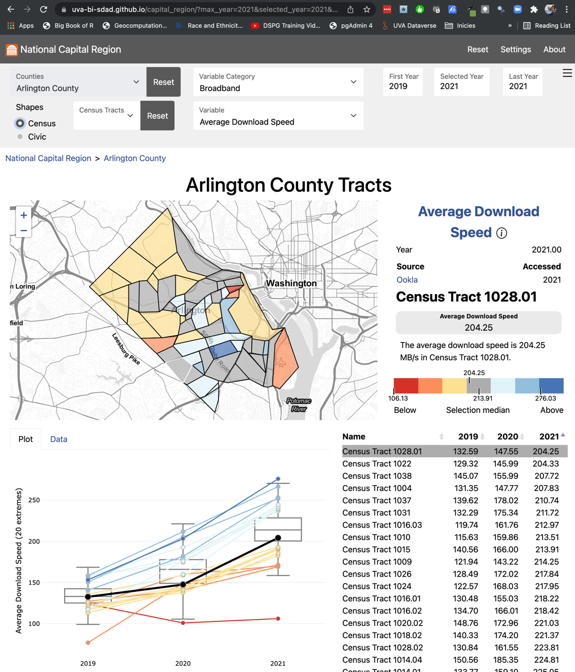
EQUITY OF ACCESS TO BROADBAND
Multiple Measures to Tell the Story
Average download speeds (from Ookla) are relatively high across Arlington with the slowest average still above 100Mb (the newer standard for “broadband”)
Ookla data only recently made available in 600-meter squares that we translated to block groups

Slide 6
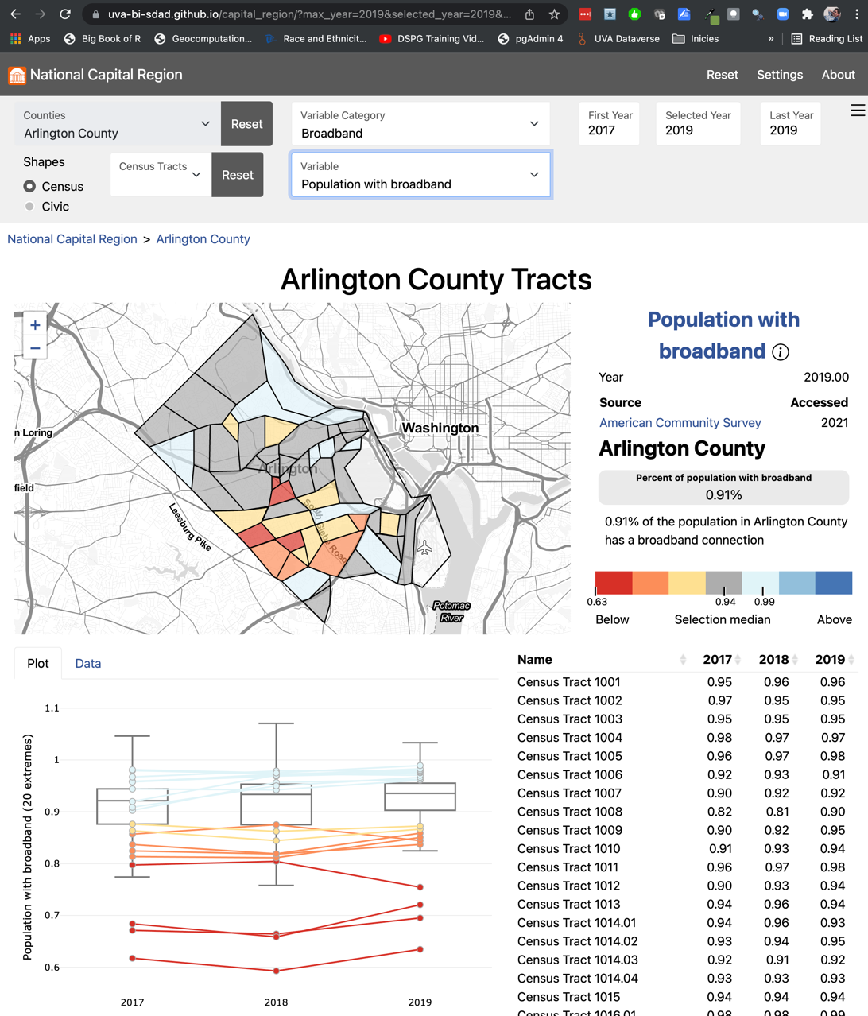
EQUITY OF ACCESS TO BROADBAND
Multiple Measures to Tell the Story
However, specific areas can be identified that have a significantly lower level of broadband adoption than the rest of Arlington

Slide 7
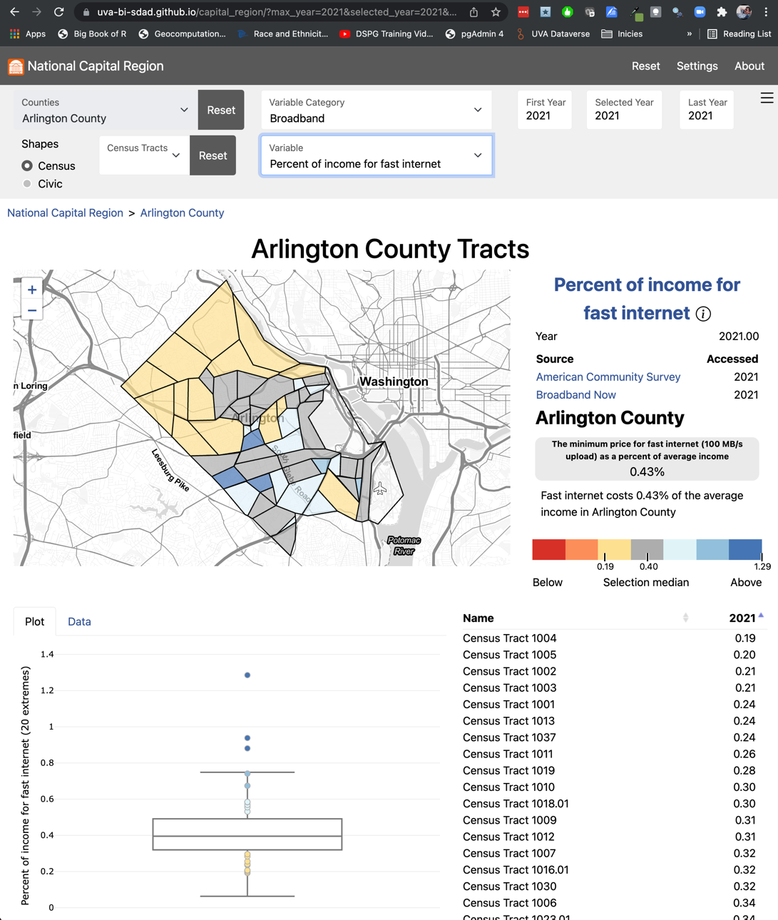
EQUITY OF ACCESS TO BROADBAND
Multiple Measures to Tell the Story
Calculated % or household income vs cost of 100Mb/s in every block group
Scraped cost of every level of data service for every census block
These areas of lowest broadband adoption appear to directly correlate with the areas having the highest ratio of household income to the cost of broadband, indicating an economic issue, as opposed to an issue of availability.

Slide 8
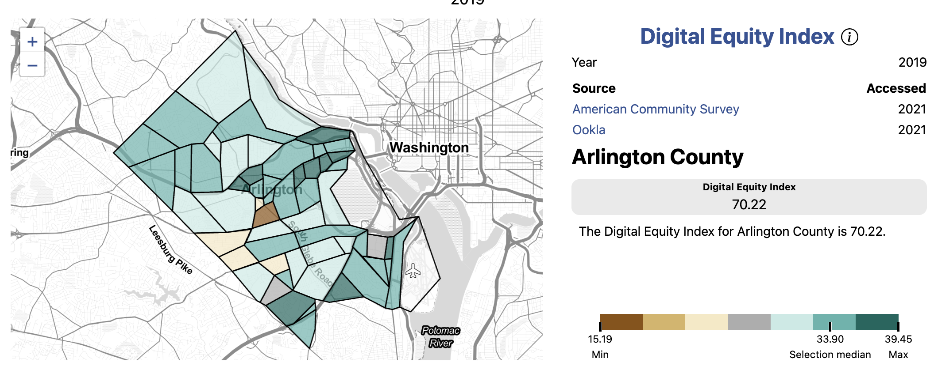
EQUITY OF ACCESS TO BROADBAND
The Digital Equity Index (DEI)
Combine these with other socio-economic variables to create completely new metric
1
2
3
4

Slide 9
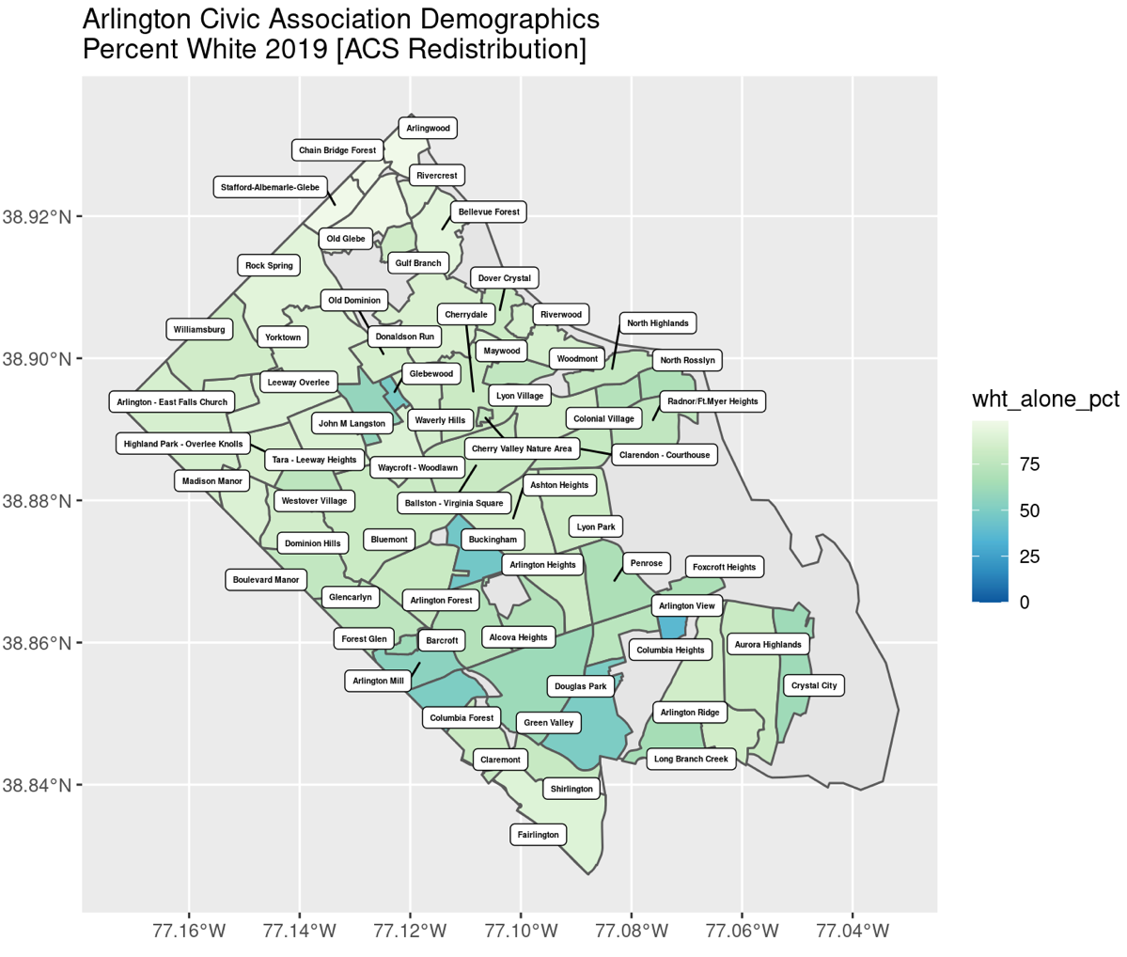
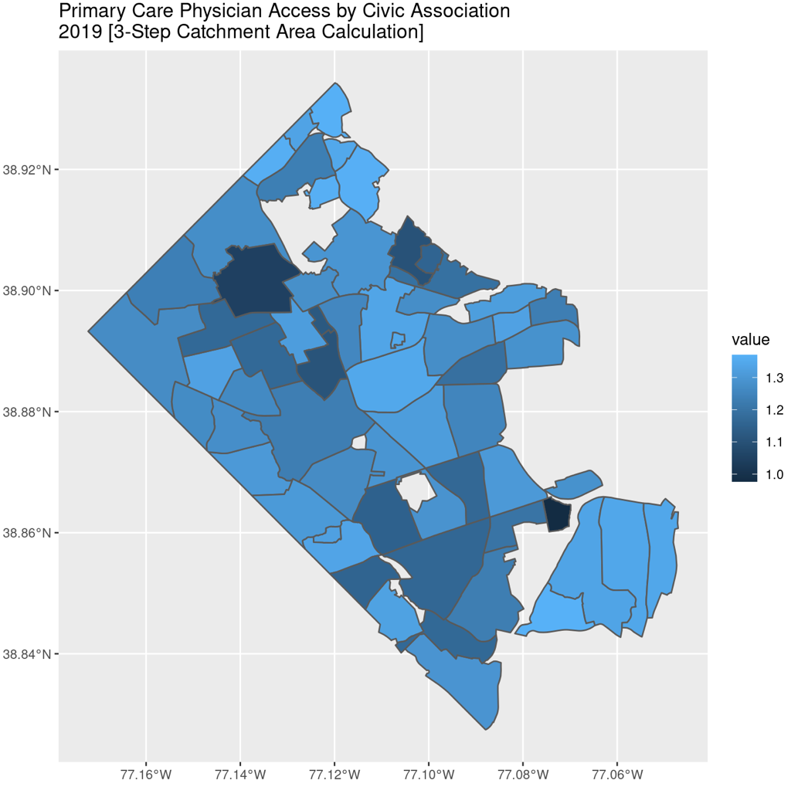
GEOGRAPHIES FOR EQUITY ANALYSIS
ACS Block Group Demographics Translated to Arlington Civic Associations
Need Civic Association Household Income Variable as Well (Coming Soon!)
Census Demographics Redistributed + Relative Primary Care Physician Access (Catchment Area)
for Arlington Civic Associations

Slide 10
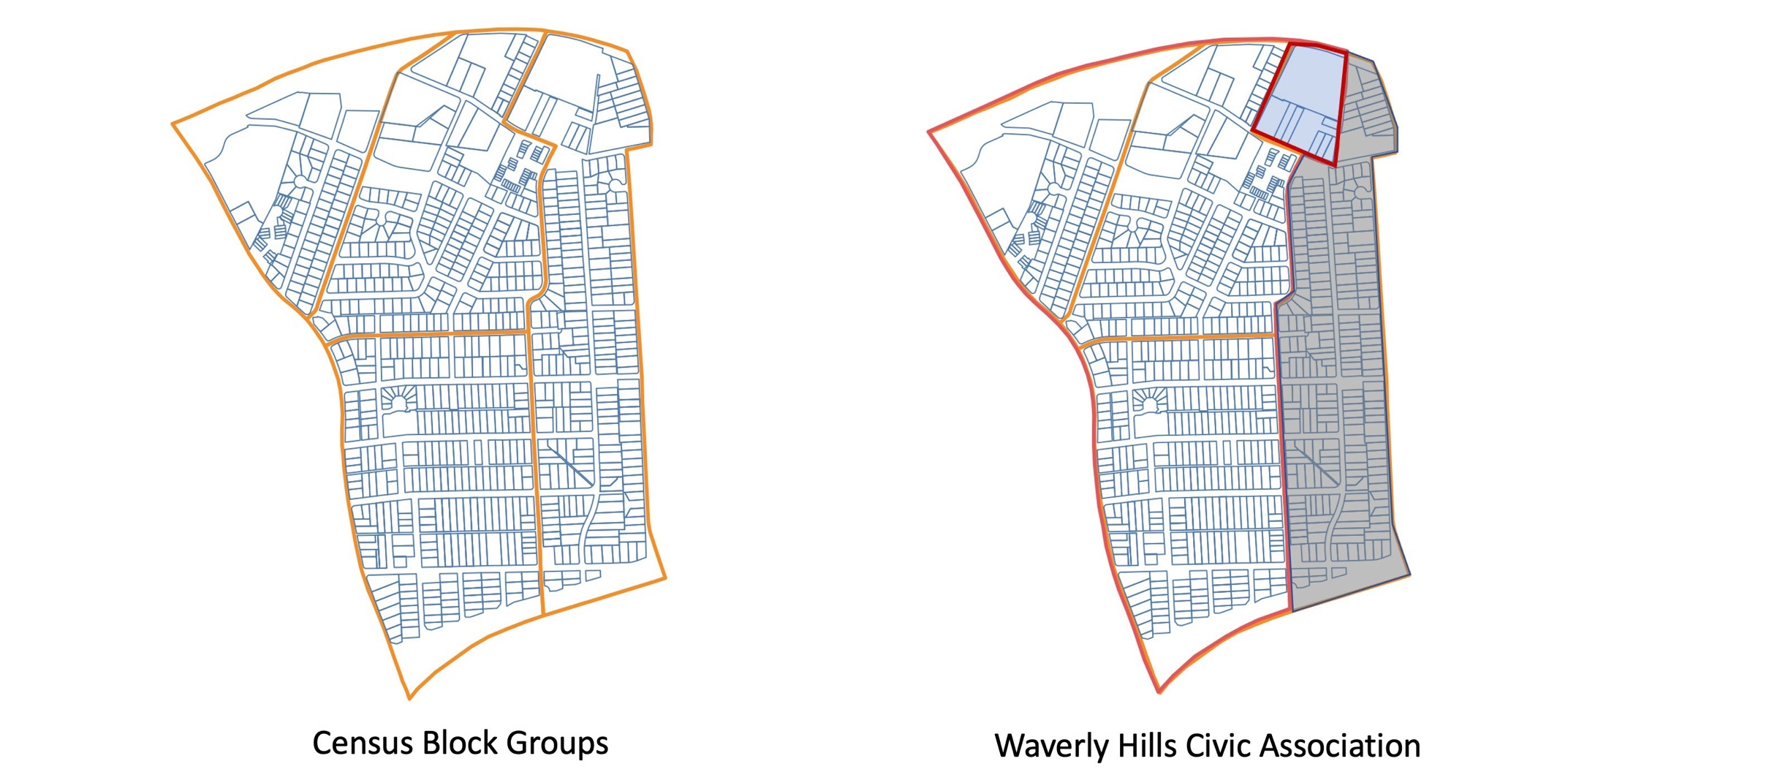
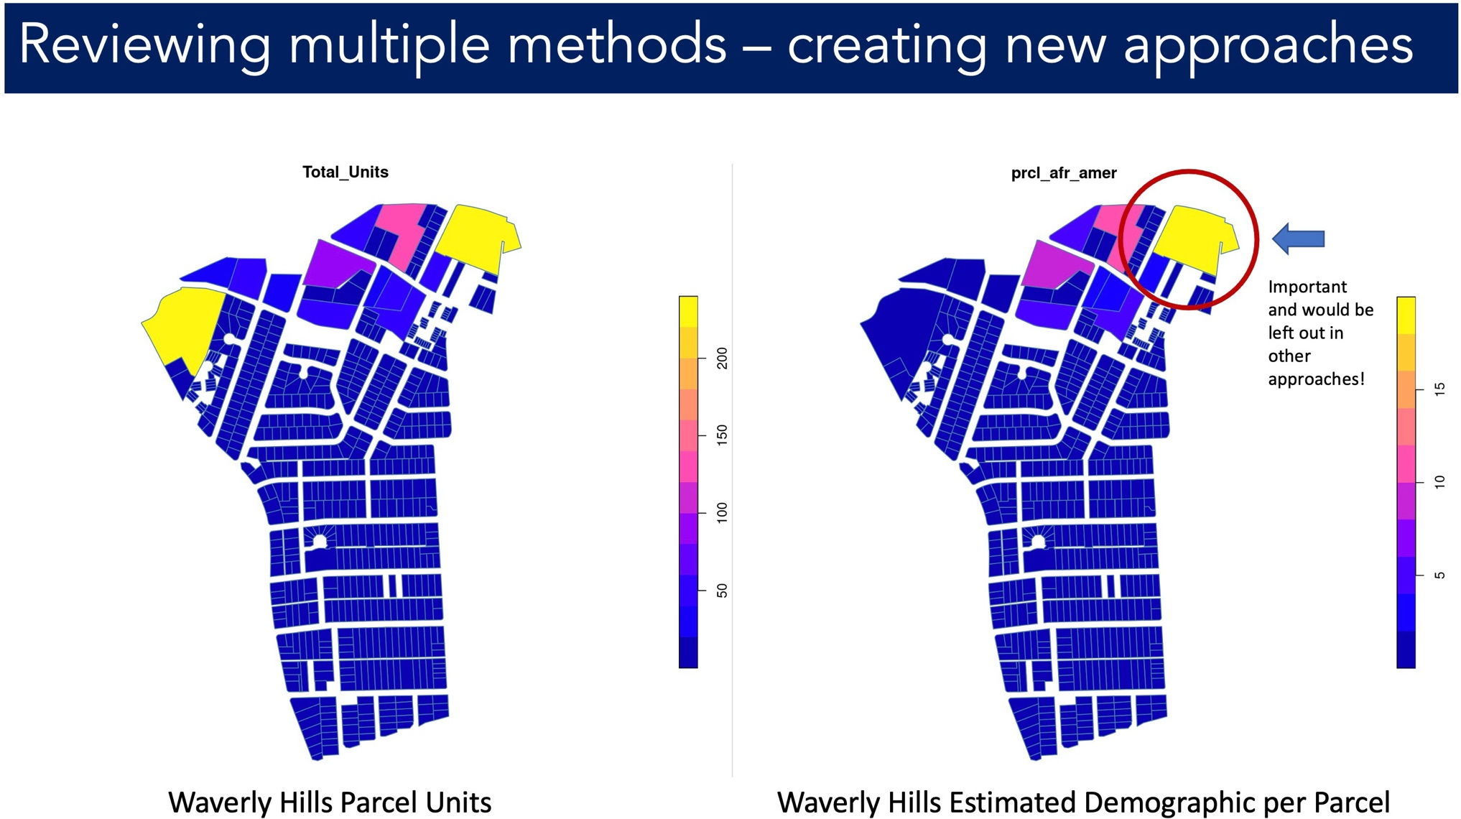
GEOGRAPHIES FOR EQUITY ANALYSIS
Creating data and metrics in geographies that matter locally
Translation of Census Demographics to New Geographies
Enabling Analysis by Neighborhood, rather than Census Geographies

Slide 11
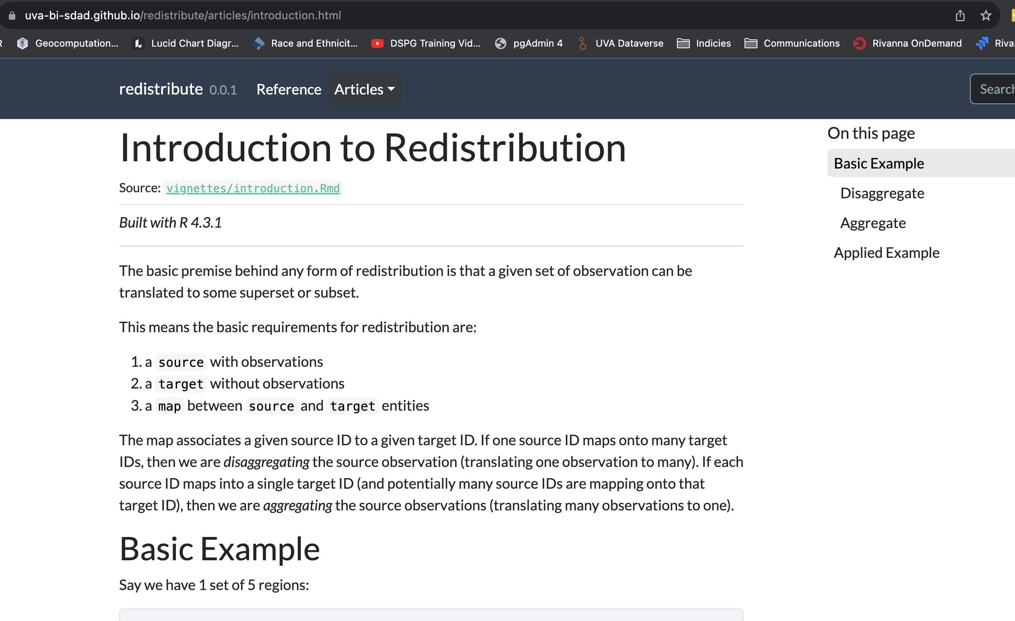
GEOGRAPHIES FOR EQUITY ANALYSIS
Creating open-source tools for dataset creation

Slide 12
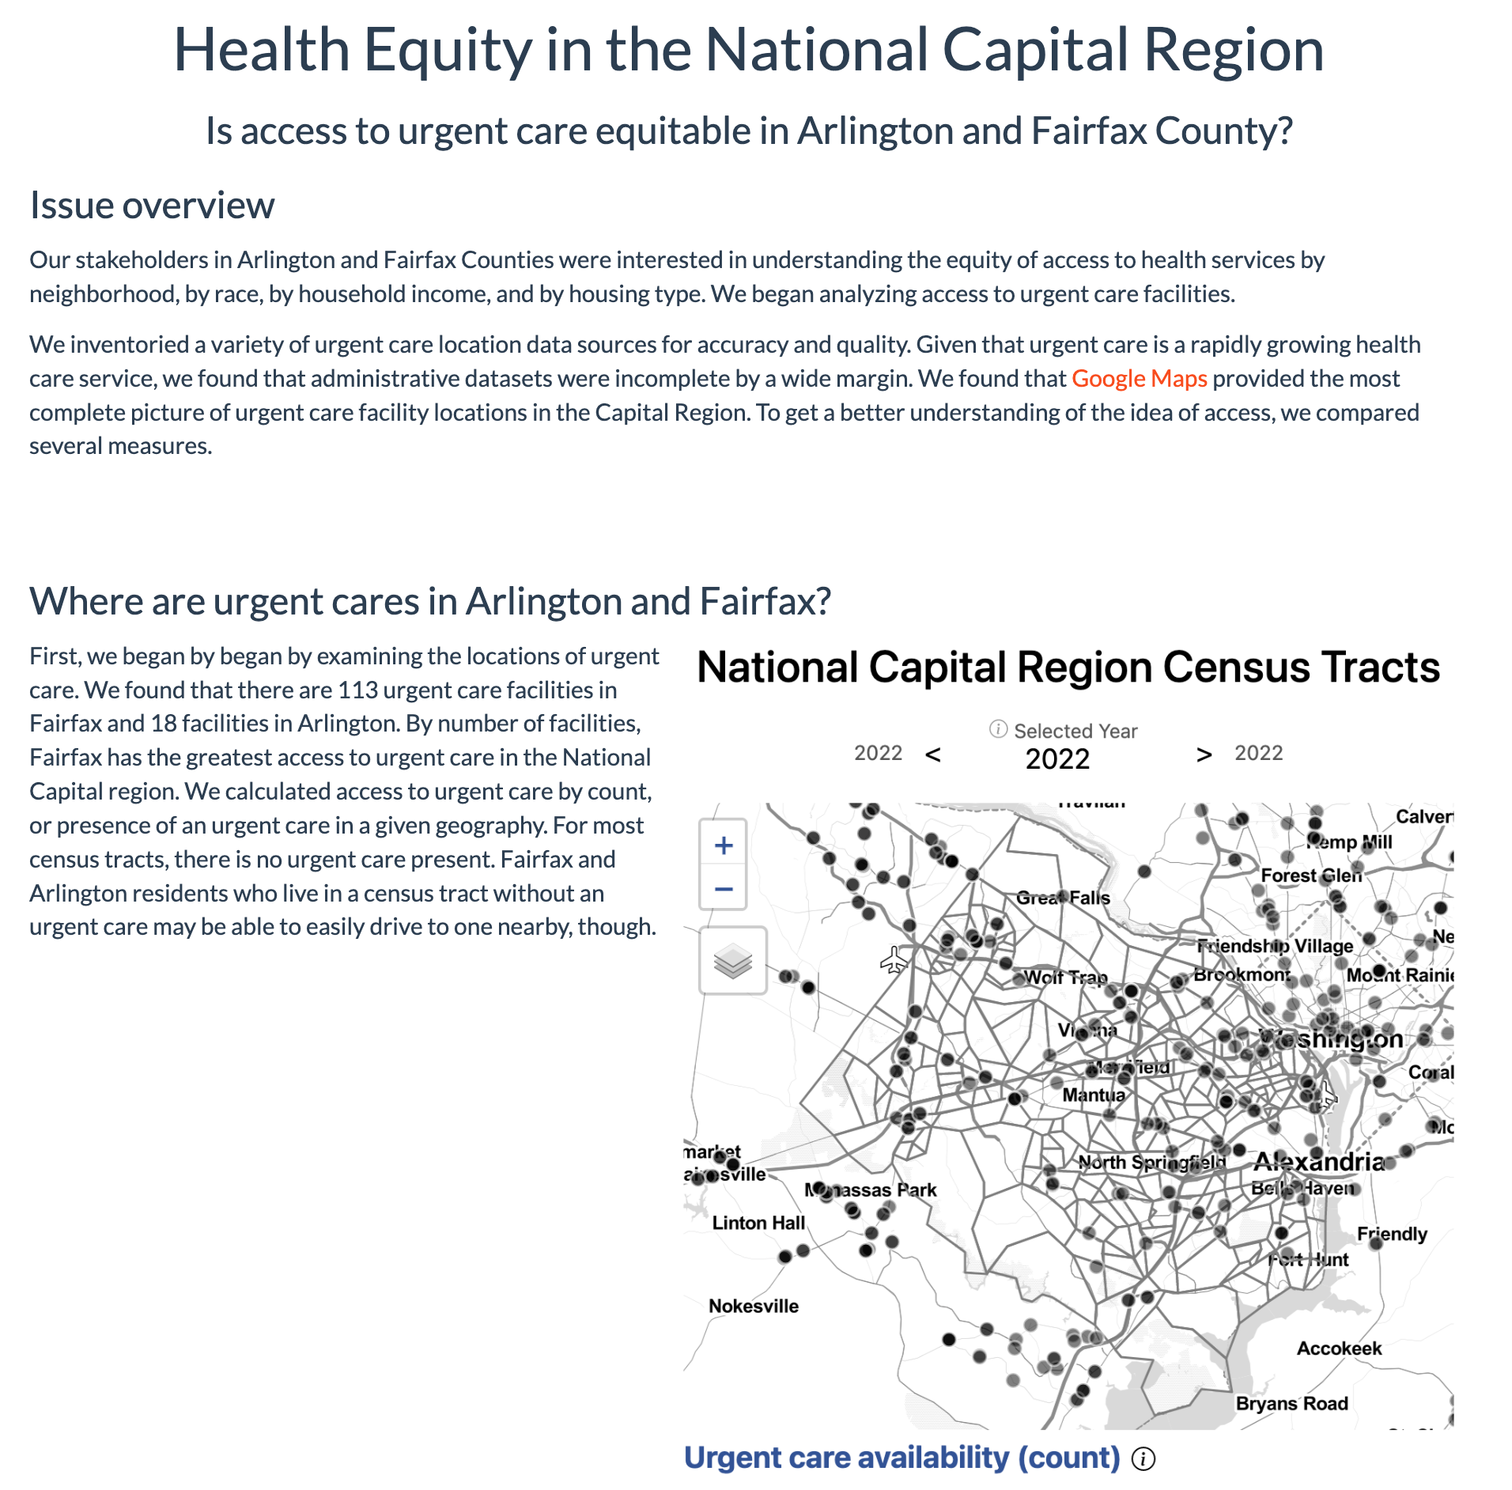
Data in action: data stories
Applies the Social Impact Data Commons to real local issues
How can measures be triangulated to tell a story?
  Access to broadband: Multiple measures tell the story in Arlington
  Health care: Is access to urgent care equitable in the National Capital Region?
  Business diversity: How do measures of equity change over space and time in Fairfax?
Available on the Social Impact Data Commons website

Slide 13
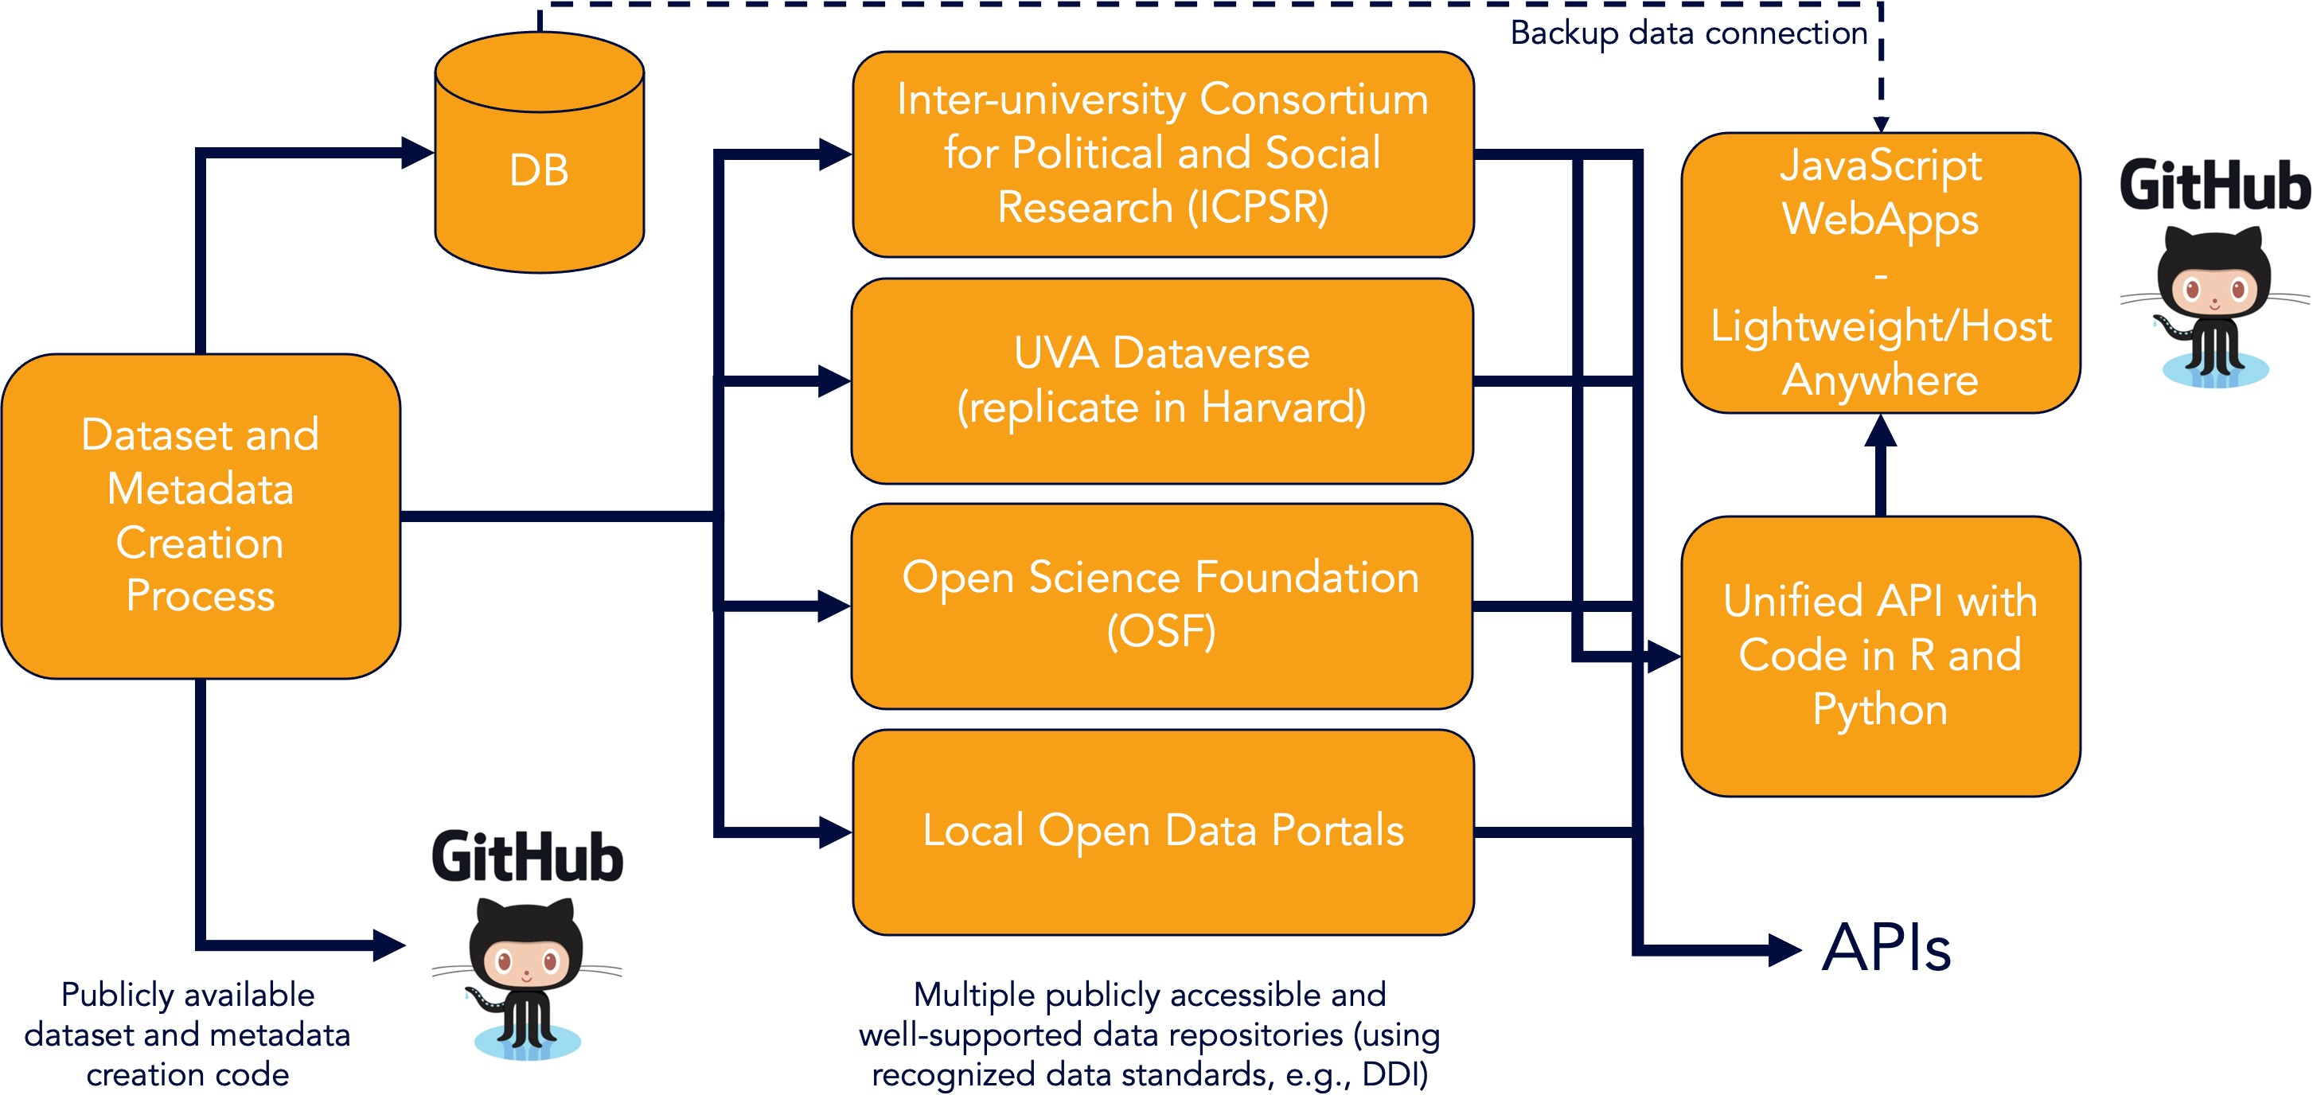
DATA COMMONS GENERALIZED ARCHITECTURE
Modular, Sustainable, Expandable

Slide 14
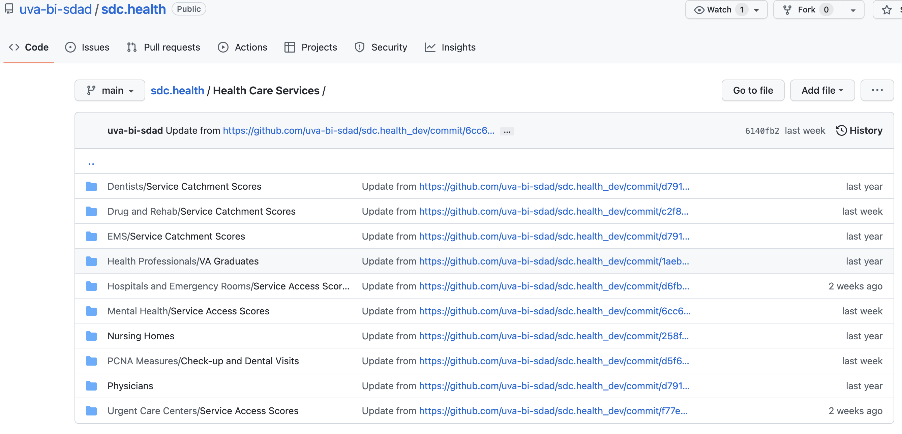
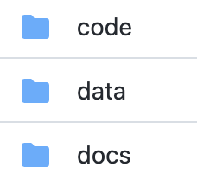











Data Repository Example: Health

Slide 15
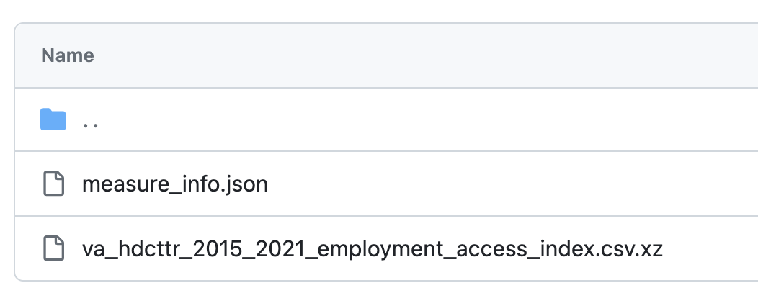
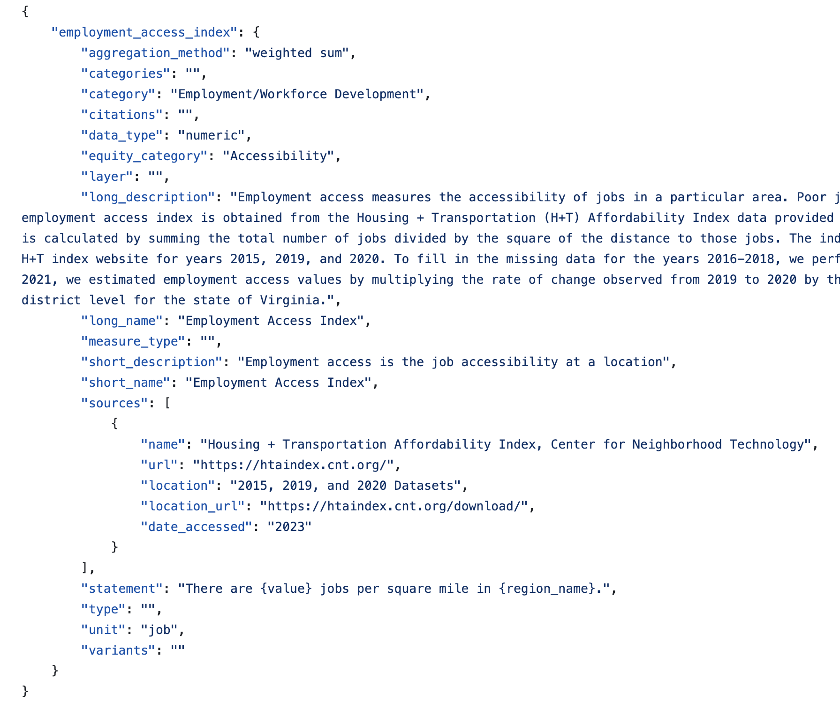
Standardization & Metadata
Full Metadata Record
Standardized Data File Names
Coverage: Virginia
Resolutions: Health Districts, Counties, Census Tracts
Years: 2015 – 2021
Topic: Employment Access Index
Everything must be both
Machine AND Human Readable

Slide 16
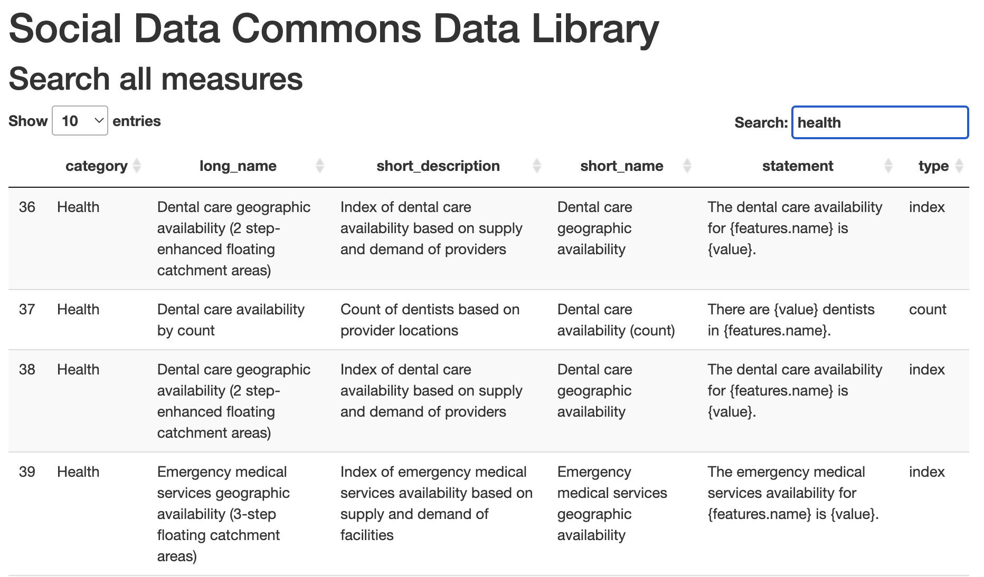
Rich and accessible metadata
Describes and contextualizes measures on the dashboard
Adheres to standards (e.g. FAIR)
Openly available online as an interactive data library

Slide 17
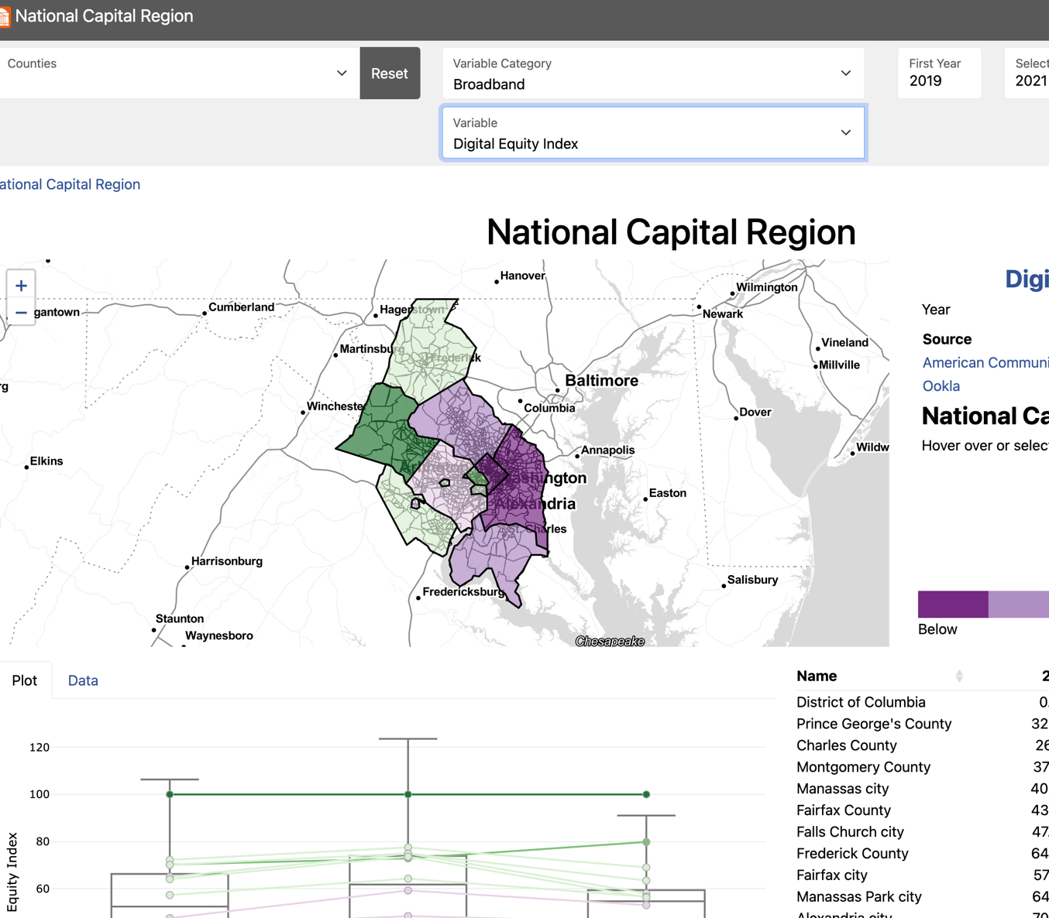
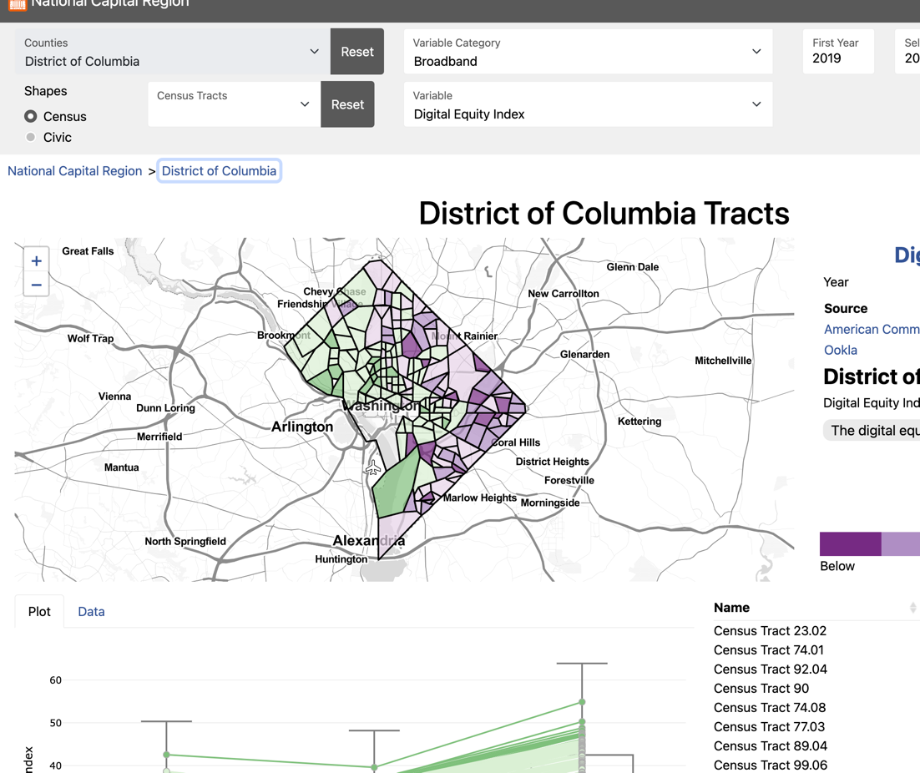
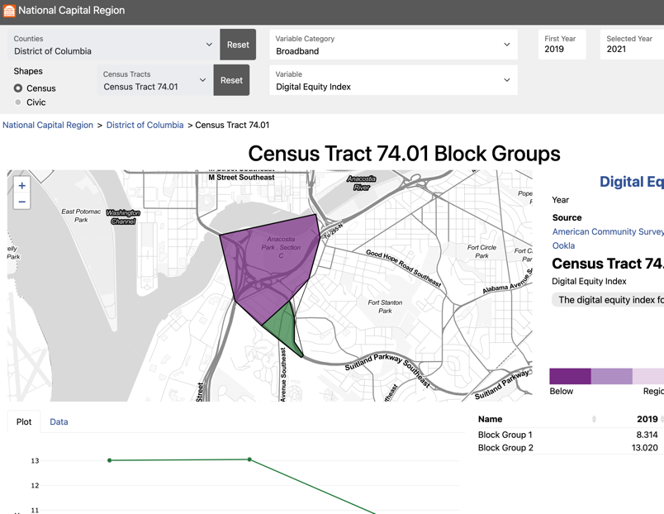
DATA COMMONS GENERALIZED ARCHITECTURE
Lightweight JavaScript WebApp, Universally Deployable:
NCR Version (this project: beta): https://uva-bi-sdad.github.io/capital_region/
VDH Version (sister project: deployed, VA only): https://uva-bi-sdad.github.io/vdh_rural_health_site/

Slide 18
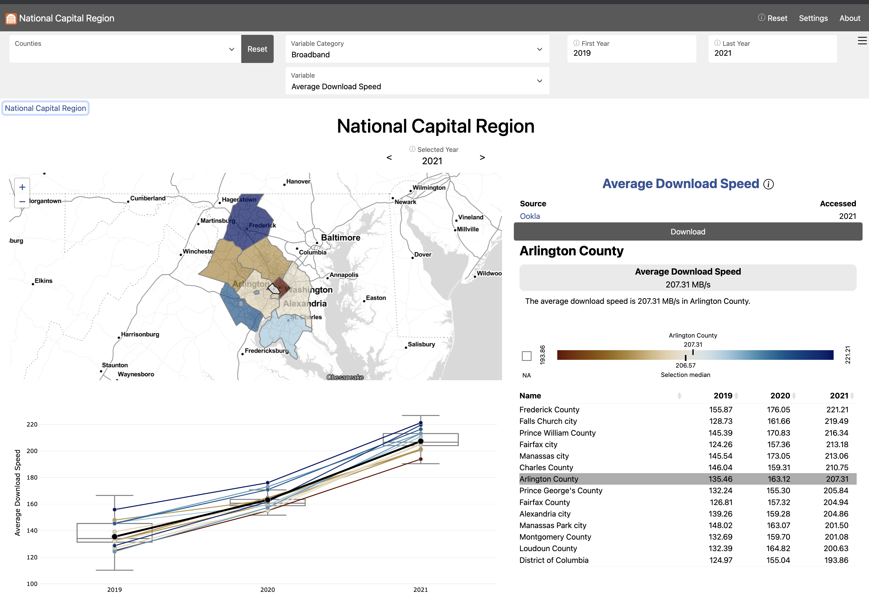
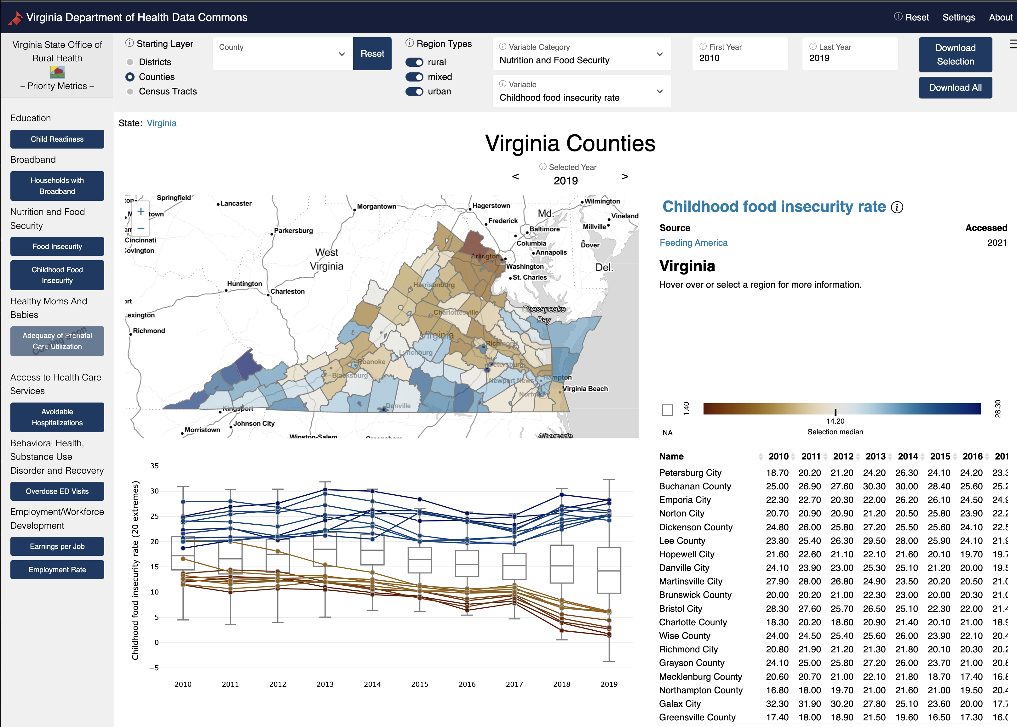
Two Data Commons Projects
1. Social Impact Data Commons to Inform Equitable Growth (Mastercard Center for Inclusive Growth) – National Capital Region
2. Data Commons to Support Department of Health Strategic Plans (Virginia Department of Health) – State of Virginia
Both applying the CLD Process to discover data needs
https://uva-bi-sdad.github.io/capital_region
https://uva-bi-sdad.github.io/vdh_rural_health_site

Slide 19
Specific artifacts of the SIDC project
An Open-Source Data Dashboard (License: CCA 4.0). A lightweight JavaScript-based data dashboard that can run on low-cost/free hosting services like GitHub.
  NCR Site (https://uva-bi-sdad.github.io/capital_region)
  VDH Site (https://uva-bi-sdad.github.io/vdh_rural_health_site)
11 Open-Source Data Repositories (License: CCA 4.0). Over 150 datasets are currently hosted in 11 repositories freely accessible via GitHub. (https://github.com/uva-bi-sdad/sdc.all/tree/main/data)
Open-Source Dataset Tools (License: CCA 4.0). Multiple R Packages used to create localized datasets.
  Catchment - An R package to calculate spatial access and availability metrics.
    https://uva-bi-sdad.github.io/catchment/articles/introduction.html
  Redistribute - An R package to redistribute population data to alternate geographies.
    https://uva-bi-sdad.github.io/redistribute/articles/introduction.html
  Food Security Calculator (Sub-County) – Created, in process of packaging
  Census-tract-level family budget calculator – Created, in process of packaging
Data Stories and Walkthroughs
  https://uva-bi-sdad.github.io/sdc.intro/health_equity.html
  https://uva-bi-sdad.github.io/sdc.intro/broadband.html
  https://uva-bi-sdad.github.io/sdc.intro/economic_diversity.html

Slide 20
Future Challenges/Opportunities
Continue Expansion of Data Commons into New Policy Areas and New Geographies (Nationwide)
Create New Policy Relevant Indicators
Maintain Data Commons on an Ongoing Basis

Slide 21
Project Information & Contacts
Project Information:
  https://uva-bi-sdad.github.io/sdc.intro
NCR Dashboard:
  https://uva-bi-sdad.github.io/capital_region
CLD3 Process:
  https://datascienceforthepublicgood.org/economic-mobility/research-framework
SIDC Measures and Metadata
  https://uva-bi-sdad.github.io/sdc.metadata/
Contacts:
  Dr. Aaron Schroeder, Principal Investigator, ads7fg@virginia.edu
  Dr. Stephanie Shipp, Co-Principal Investigator, sss5sc@virginia.edu

